Slide 1
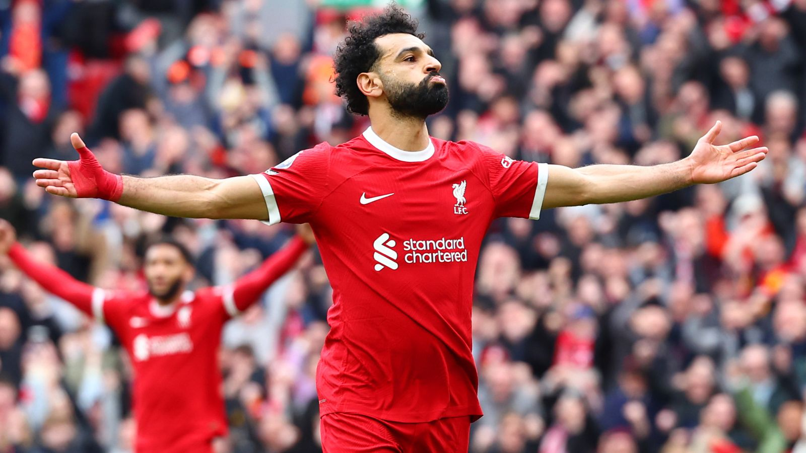
Scouting Report on Mohamed Salah’s Replacement
Course: SP 7042
Author: Tian Jiang
Date: 15/May/2024

Slide 2
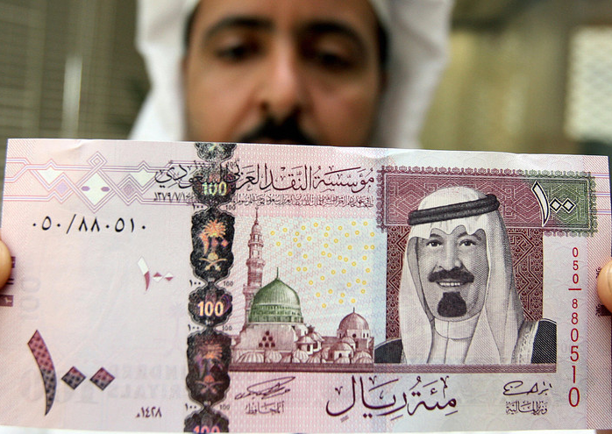
Scenario:
M.Salah is moving to Saudi Arabia for around 150-200M £ in the summer of 2024, we must find a replacement for him. Since Jurgen Klopp will step down in the end of the season, his assistant Pepijin Ljinders is going to promote as the head coach of the team so that Liverpool will remain the same play style.

Slide 3
Selection Process:
Identification of the play style of Liverpool and M.Salah;
Selection 1 based on FBREF’s 5 major European leagues for the past 3 seasons, with criteria on Min Played (>=3000m), Age (<=26), Goals Scored (weighted as per season) and Goal Conversion Rate;
Selection 2 is a complementory of the 1st selection to avoid any elimination of suitable players. Criteria as Attacking Contribution and Goals-xG are applied.
Selection 3 aims to cut unrealistic targets and players below a certain bar on Defensive Contribution and Attacking Contribution per 90.
We finally get a list of 6 players whom we will analyse individually afterwards.
Extra layers added to complete the process such as players’ physical data (Distance Covered/90 & Top Speed) plus their social media analysis (based on their most recent 100 post on Instagram).
Giving a ranking on the players based on the 3 core factors (technical, tactical & physical) for the final recommendation.

Slide 4
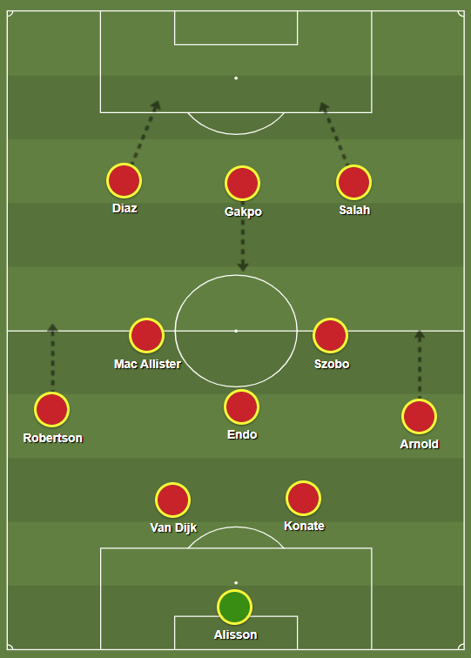
Liverpool’s Play Style:
Possession based attacking football;
Intense high pressing & counter-pressing with a high defensive line;
Fast counter-attack;
Energetic positional attack with flexible rotations among the attackers.

Slide 5
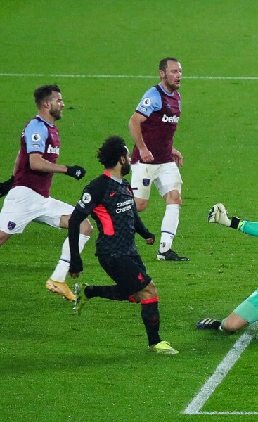
Salah’s Play Style at Liverpool:
Top of the Squad - Occupys 24% in Liverpool’s Total Goals Scored during 2021-24 (59/246)
Inverted right winger who drifts inwards frequently;
Many runs behind the opposition’s backline for direct goal-scoring opportunities;
Big threat in counter-attack with his lightning speed.
Able to move out wide or drop back to receive the ball for combinations with teammates.
Decent dribbling/ball control skills making the opponents hard to dispossess him.

Slide 6
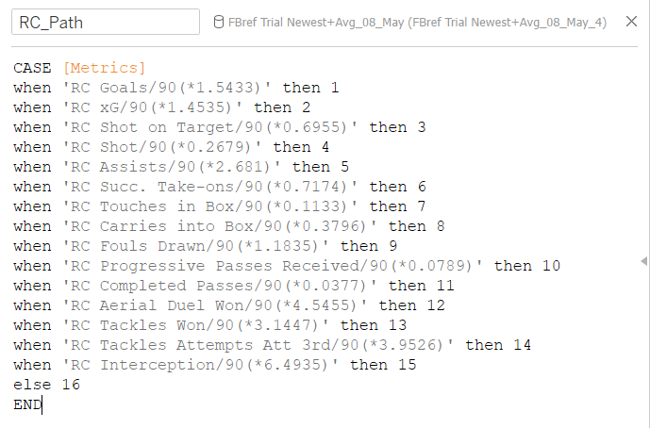
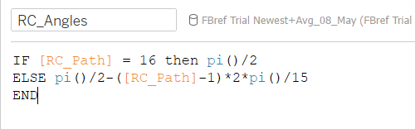
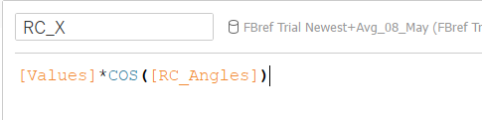
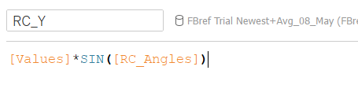
Formulars for the making of radar chart

Slide 7
Resourses:
FBREF - URL
Instagram
uefa.com - URL
liverpool.com - URL
ligue1.com - URL
alimoshotoday.com - URL
bundesliga.com - URL
givemesport.com - URL
transfermarkt.com - URL

